Slide 1

Real-Estate Israel 2020 ___________________________________________ The pursuit for an asset

Slide 2
Students
204269245Moshe Gorgy
Yarin Mordechay 308034826
311317937 Ron Daniely

Slide 3
Project files Breakdown
Step 1 – Data acquisition:
scraping and framing.ipynb - scrape from “Yad2”, apartments for sale
scraping and framing.ipynb - scrape from “Yad2”, sold apartments
Step 2 – Data cleaning:
Forsale_cleaning.ipynb - cleaning for sale data csv file
rent_cleaning.ipynb - cleaning rent data csv file
sold_cleaning.ipynb - cleaning sold data csv file
Step 3 – Exploratory Data Analysis:
EDA.ipynb – plotting charts from the clean data
Step 4 - Predicative ML Experiments:
ML-apartments for sale price predictions.ipynb – deploying predictive models and web app
ML-rental price predictions.ipynb – deploying predictive models and web app

Slide 4
Summary and introduction
The ability to buy or rent an apartment in Israel is not simple at all, especially for guys like us, the students, that cannot work continuously
We decided to analyze this issue and examine the various data available in the network on apartments for rent and sale to understand what effects the most on the prices and if the price really worth it
In addition, we will try to understand the impact of Covid-19 epidemic on the real estate market

Slide 5
Main Objectives
Search and acquire data on the Real-Estate market in Israel
Performing a comprehensive analysis of the real estate market in Israel according to various parameters.
Creating a machine learning model for forecasting rent and asset values according to the data available on the network.
Deploying an Web app that will predict assets value according to the best model available

Slide 6

Data Acquisition

Slide 7
How did we create the database?
Scraping posts of apartments for sale from “YAD2” website and convert it into a data-frame.
Scraping posts of sold apartments from “YAD2” website and convert it into a data-frame.
Managed to purchase a big database that contain more than 600,000 posts of apartments for rent and convert it into a data-frame.

Slide 8

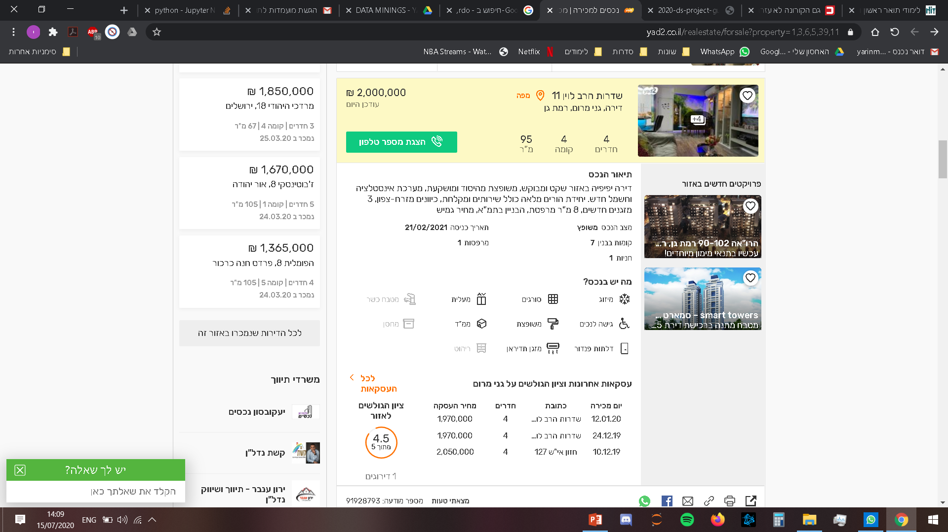
Scraping from
We used the following libraries to perform the scraping :
BeautifulSoup
Selenium
Scraping features for each post of apartments for sale:
Scraping features for each post of sold apartments:
Address
Number of rooms
Price
Sale date
Creating a Pandas Data Frame for each of them, which contains each apartment and its data
Address
Price
Number of rooms
Floor
Size
State of asset
Facilities
Entry date
And more

Slide 9

Data cleaning

Slide 10
How did we cleaned our data?
After we created the data frames, we started cleaning up each table according to:
Unnecessary features - checking which features are important for the research
Missing data (NANs) - cleaning nans and fill part of them with median/mean
Incorrect data (user input errors) - checking with value counts the categorial values and combine them by using regex and text processing
Fixing data types - converting the Types to numeric and datetime
Outliers - cleaning outliers with median and IQR methods
Duplicates – checking and cleaning duplicates rows

Slide 11

OUR DATA- Data Cleaning Changes
NUMBER OF FEATHERS before/after cleaning |  | NUMBER OF POSTS before/after cleaning |  | DATA’S NAME
16 | 591356 | 48 | 699160 | Apartments for rent
20 | 27035 | 24 | 28777 | Apartments for sale
7 | 39972 | 7 | 42339 | Sold apartments

Slide 12

Exploratory Data Analysis

Slide 13
How did we created the charts?
To create the charts we used the cleaned data for each table and we created a tables that relevant to the question
We used Plotly library for plotting interactive charts

Slide 14

Now, let’s answer these next questions:
Which cities have the most rental/sale offers? => popularity
In which cities the cost of living is the most expensive?
Which cities have the largest gaps between the demand price and the selling price?
In which cities we will have the highest value for the price we paid?
How did the Covid-19 Pandemic affect the market prices?
click each graph for more information

Slide 15
Popularity- most rent/sale offers per city
As we can see from Pie graphs in the next page, Tel-Aviv is the city with the most offers for rent and sale
It doesn't say this is the most popular city to live in, we can see that Jerusalem is right after Tel-Aviv. As we know it’s all about the asking price, Tel-Aviv has the heights asking price for sale or apartment
From the graph of the apartments that sold (right graph) we can see that Jerusalem is the most popular city to live in with the highest percentage of 10.8%, and of course this also applies on rented apartments

Slide 16
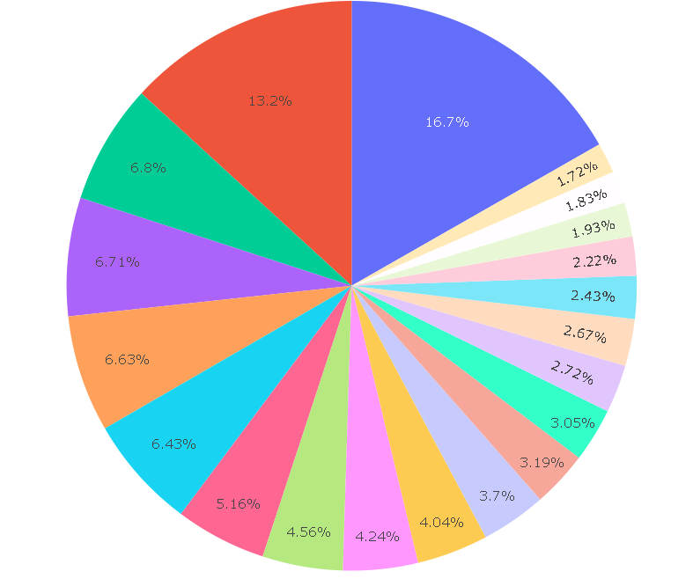

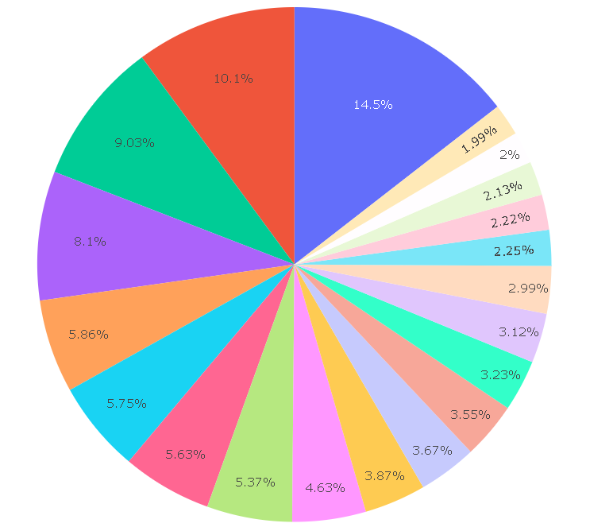

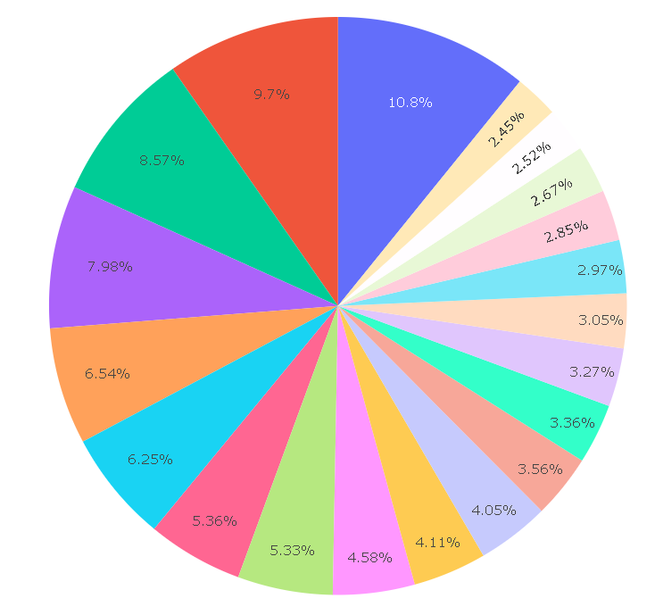

Popularity- most rent/sale offers per city

Slide 17

In which cities the cost of living is the most expensive?
It is very clear to see from the graphs that Tel- Aviv is the city where the apartments owners demands the highest prices for rent and for sale
We can see that Tel-Aviv has the largest gap between the asking price and the final sale price, we are talking about an average number of 1.5 million new shekels!
These graphs lead us to another analysis that show us in which city we will get the best value for our money

Slide 18
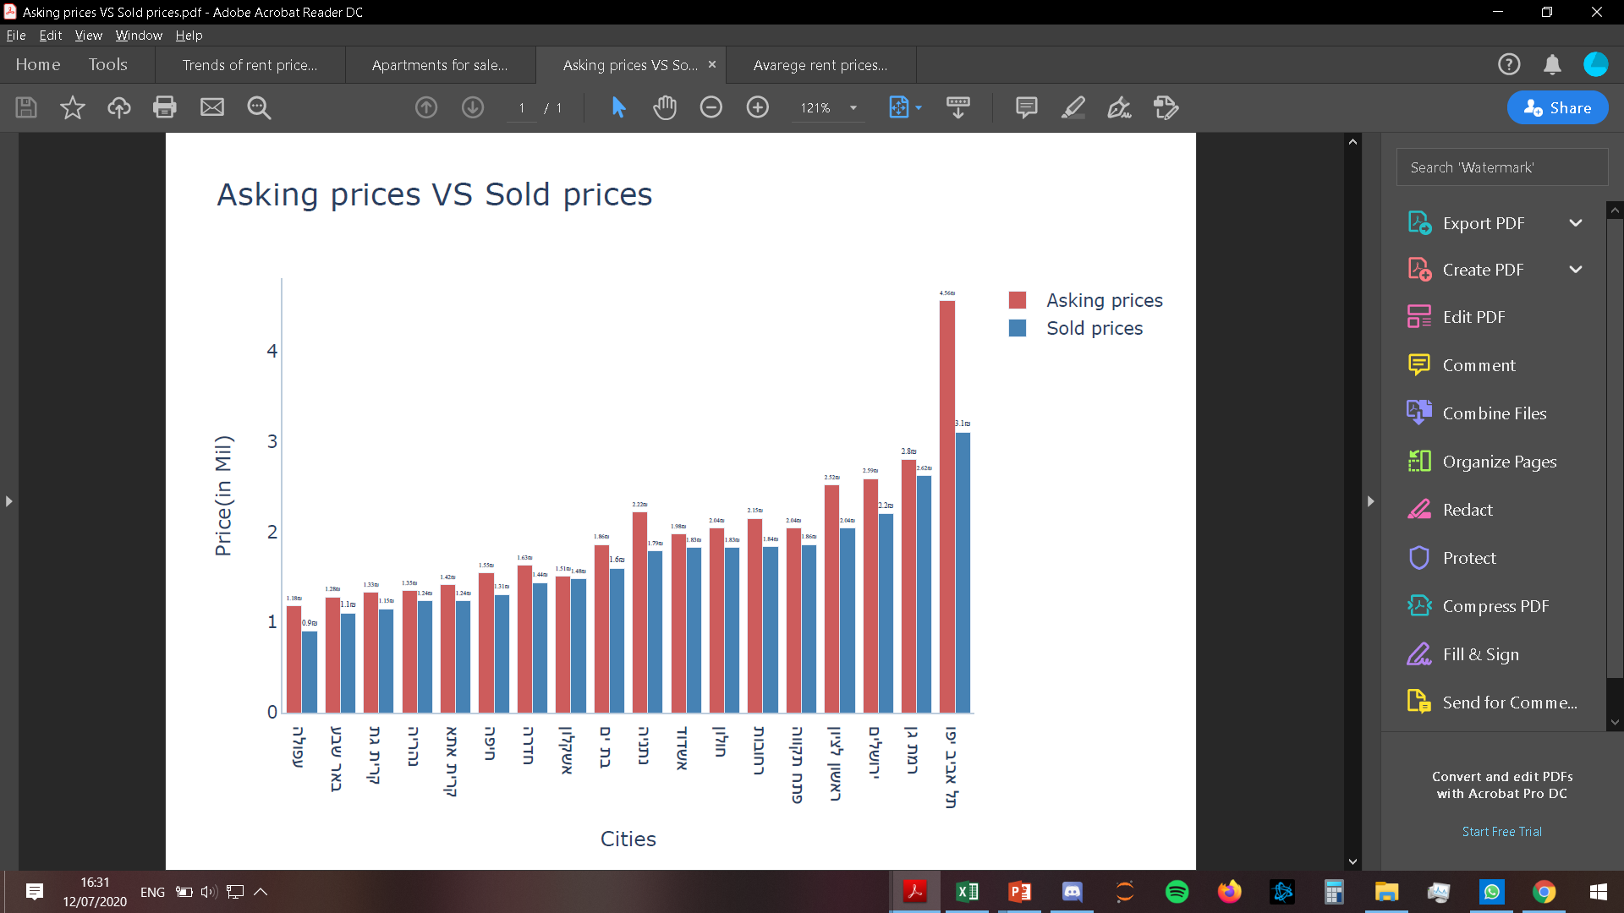
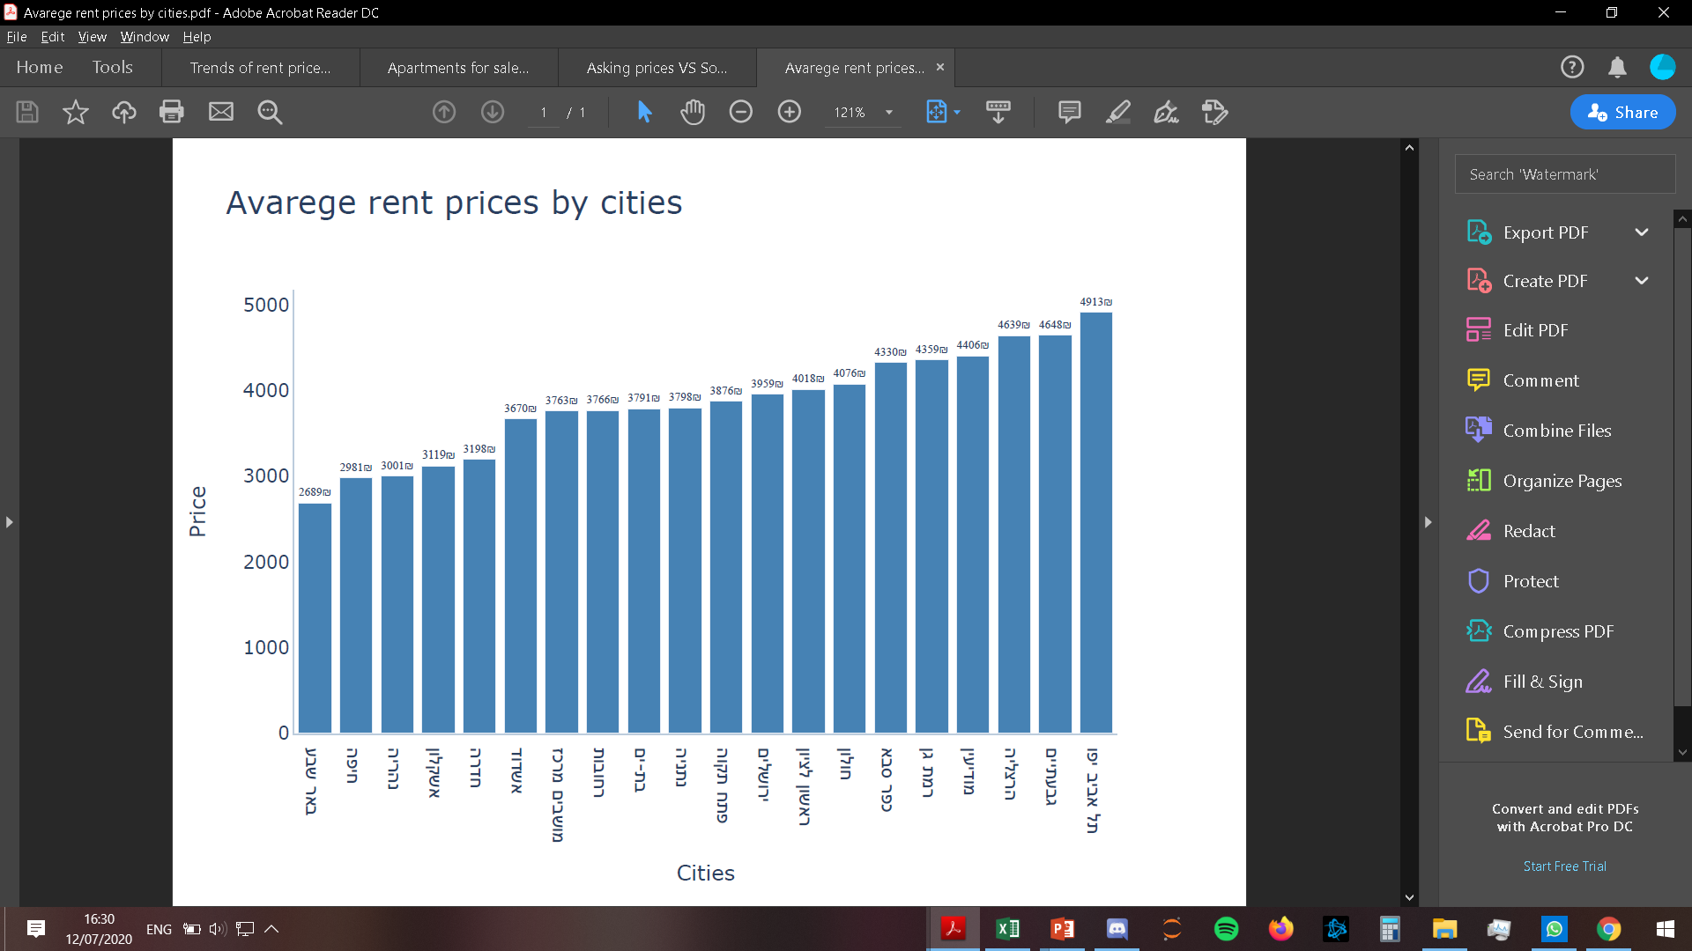
In which cities the cost of living is the most expensive?

Slide 19
Best values – Which cities gives the best values for money
We have 2 graphs in the next slide : we chose 20 central cities and put the other ones as “others”
Apartment for sale vs grade of apartment
Apartment for rent vs grade of apartment
In these graphs we have divided the facilities of the apartments according to the following categories:
It is important to note that we did not take the geographical location of the city in the country as a part of the calculation of its rating. This rating is based on the apartment’s facilities only
From the graphs we can see that the cities with the highest score combined with a low price will give it the best position / score
The cities with the best position / score that stand both for sale and rent are:
Ashkelon
Nahariya
Hedera
Beer Sheva
And this is because they have the highest score relative to the average prices which are among the lowest
Property type
Property condition
Number of rooms
parking
air conditioner
Elevator
Sun boiler
storage room
Bomb shelter
Window borders

Slide 20
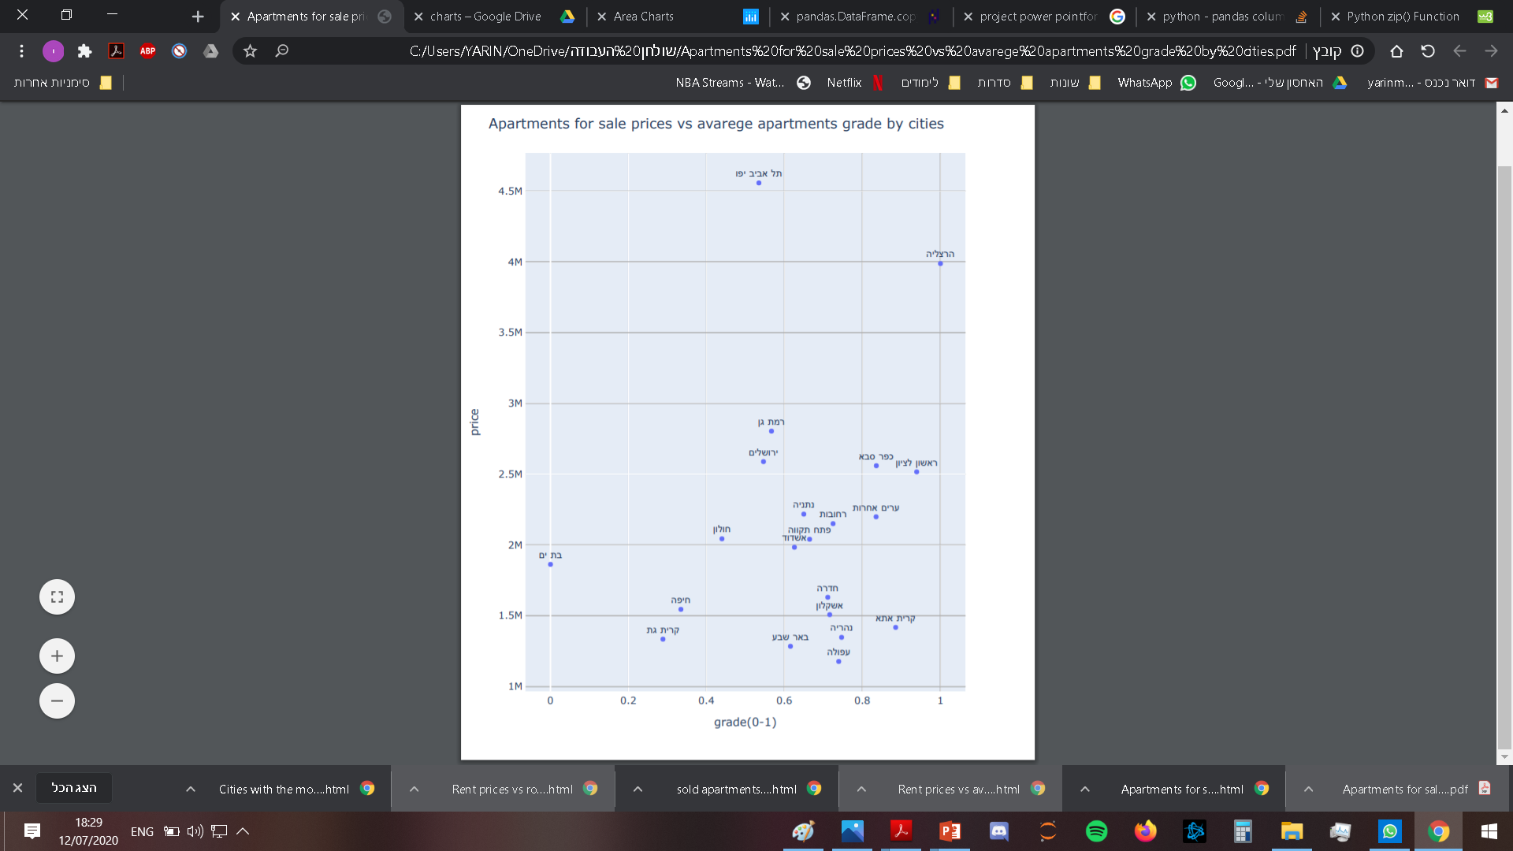
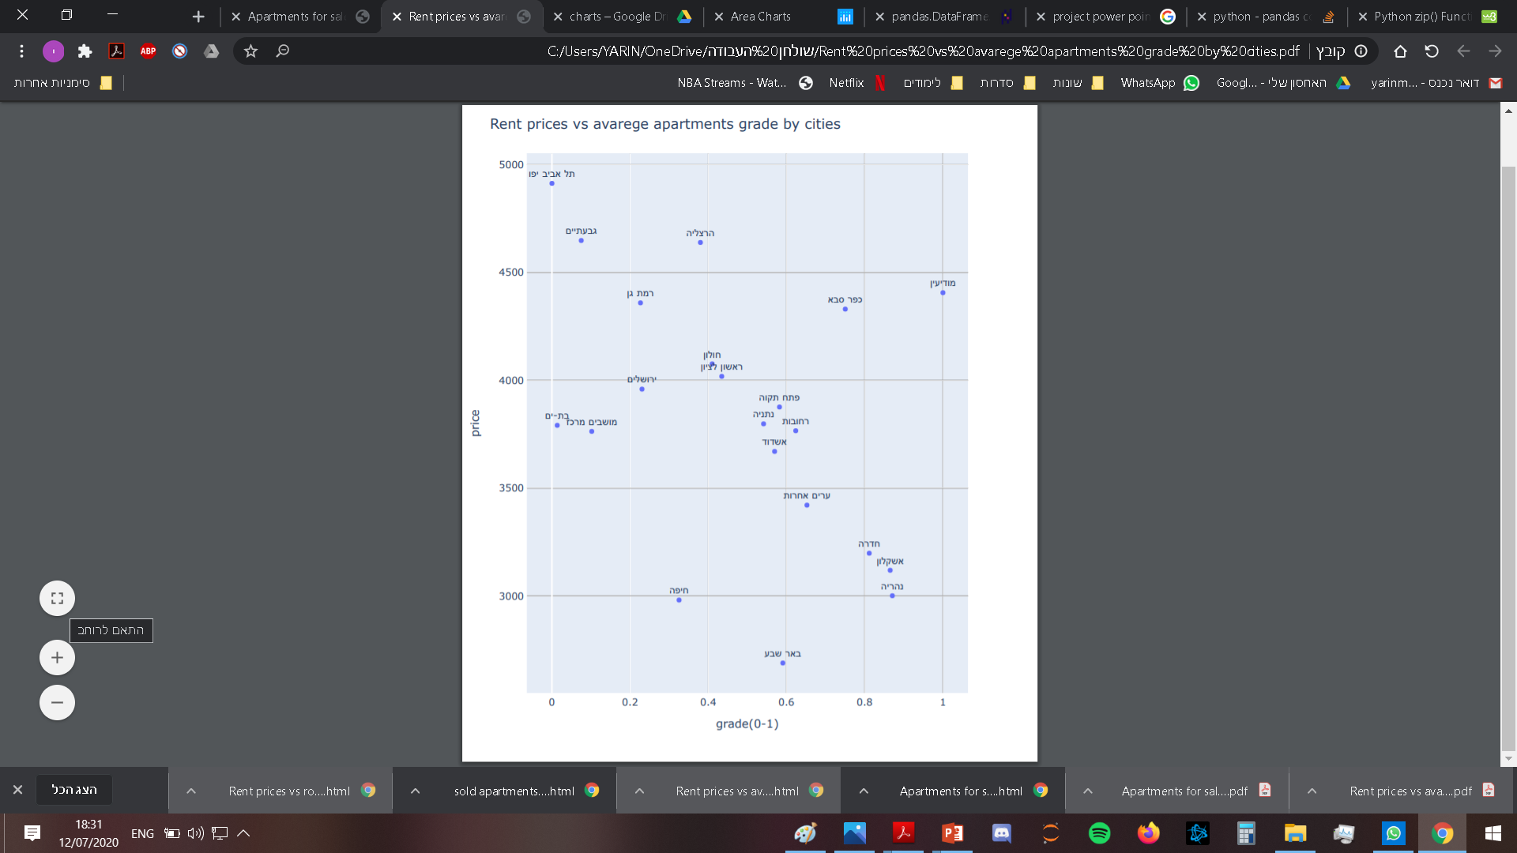
Best values – Which cities gives the best values for money

Slide 21

The influence of Covid-19 on the market
The COVID-19 Pandemic affected the entire country in all sorts of aspects. One of them, of course, is the apartment industry. Due to the situation where people could not work and earn money for living, their additional source of income is their assets.
We can understand from the charts on the following pages that the pandemic had an bad influence on the prices in the market…

Slide 22
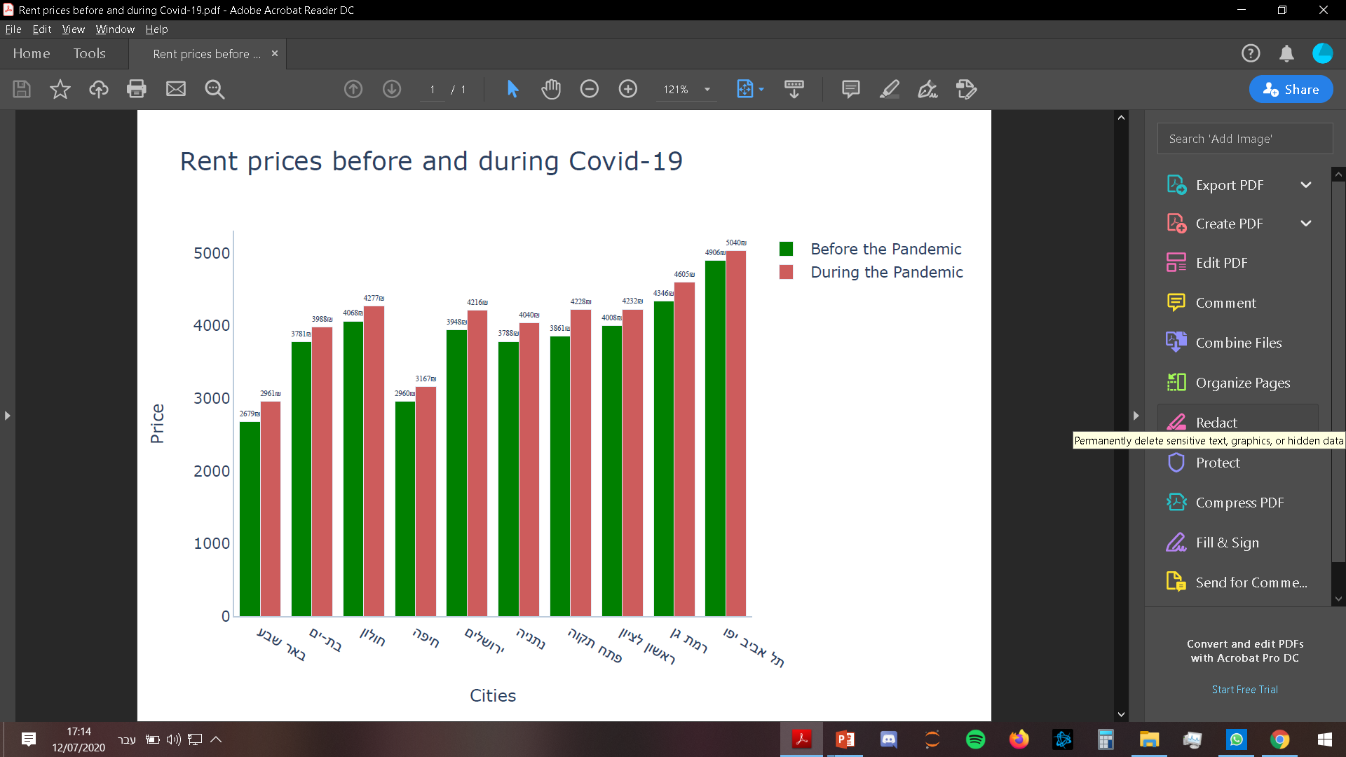
From this graph we can see the changes of the prices before and during the “first round” of the pandemic in Israel in some central cities.
The differences in these periods of time are between 3% - 10% higher.

Slide 23
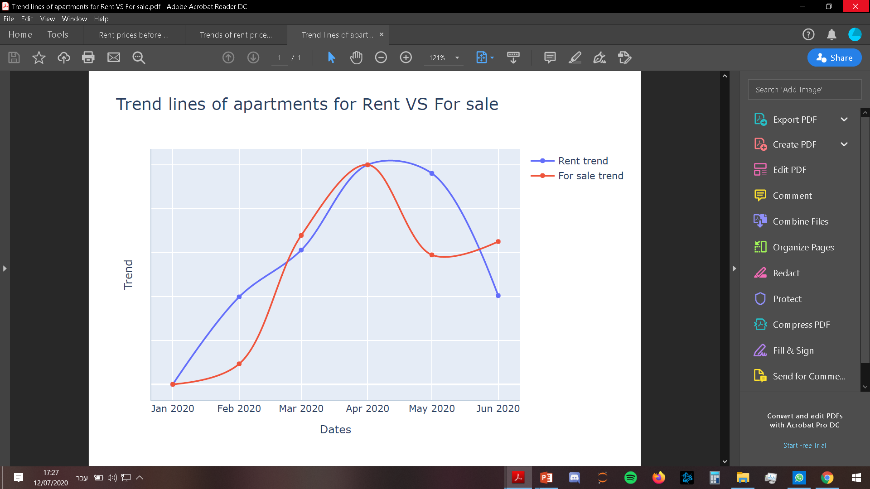
From this graph, we can see that in April the prices were at their peak for sale and rent.

Slide 24
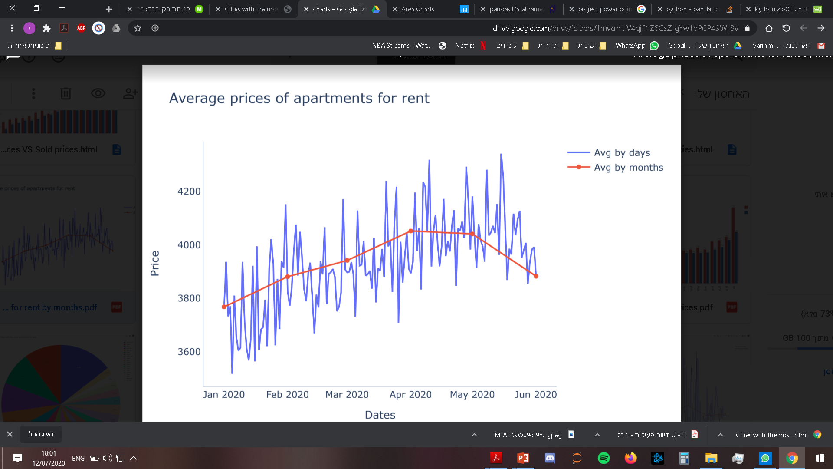
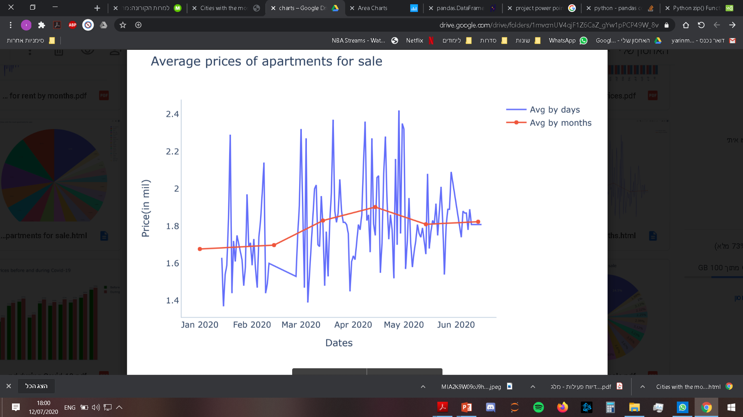

The influence of Covid-19
In these graphs we can see a national average price of apartments that stand for rent and sale. Here too it is easy to see that the peak of prices during the Pandemic were in April.
The data we analyzed can be compared to the information published on the news sites and see that the data is indeed similar.

Slide 25

Predicative Machine learning Experiments

Slide 26
Supervised Machine learning
After all the processes we made, our main goal is to predict the price of any apartment for sale or rent based on the features given
For this mission we used three different regressions models to look for the best results:
Linear regression
Lasso
Random Forest Regressor
For each model, we preprocessed the data by encoding the categorical features and scaling the values.
The X represent all the parameters are given on the assets and the labels (Y) are the rent prices and the assets prices value.
Eventually we took the model with the best results and created an web app that calculate and predict the prices

Slide 27
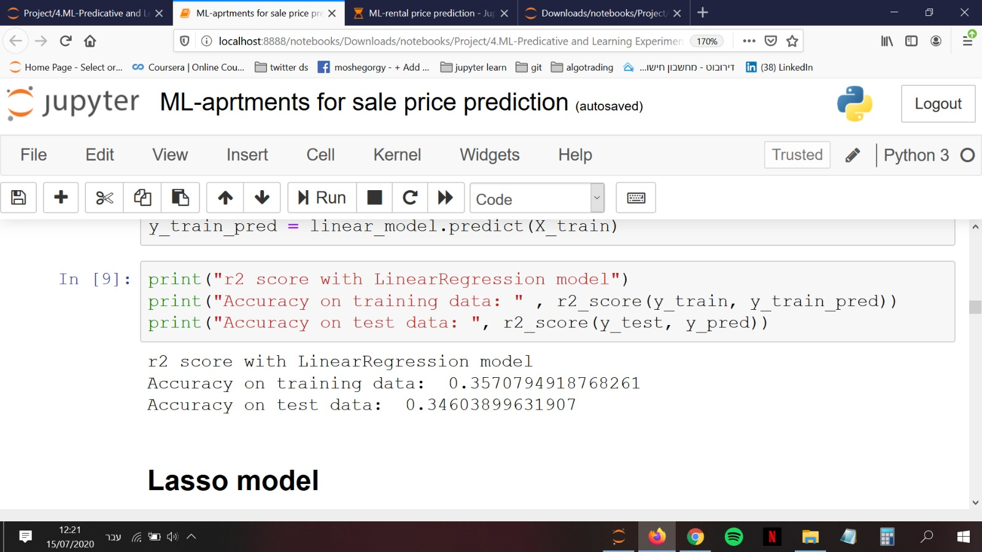
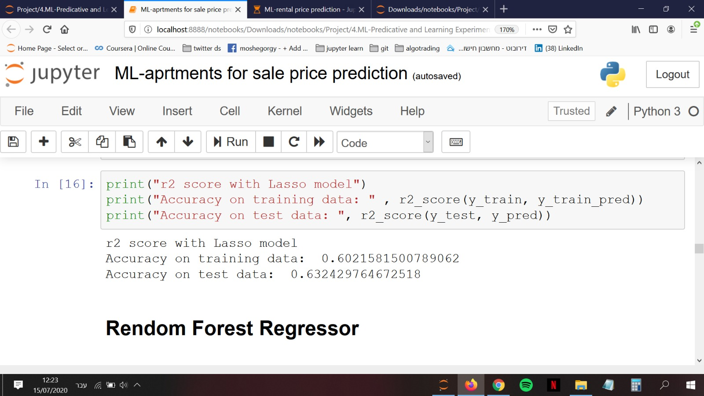
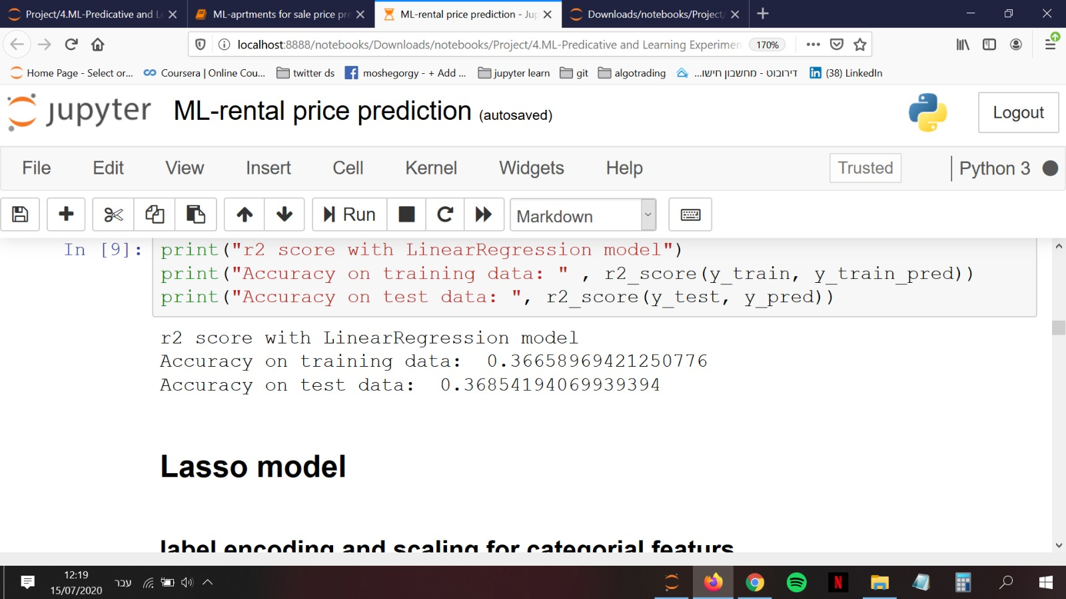
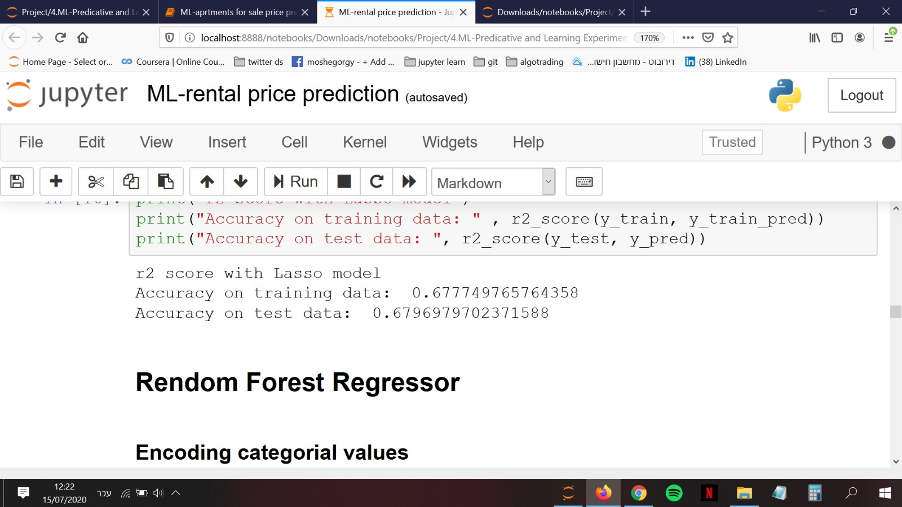
Linear regression and Lasso
Apartment for Sale:
Apartment for rent:
Apartment for Sale:
Apartment for rent:
First we checked the correlation of the features on the price, than we dropped the unnecessary columns.
We converted the categorical features to numerical numbers using LabelEncoder and GetDummies
We scaled the features using scale and StandartScalar
Eventually we split the data to train and test, and than created the model and got these results from r2score function
We saw that we get better accuracy with Lasso model, but still it wasn't enough for us

Slide 28

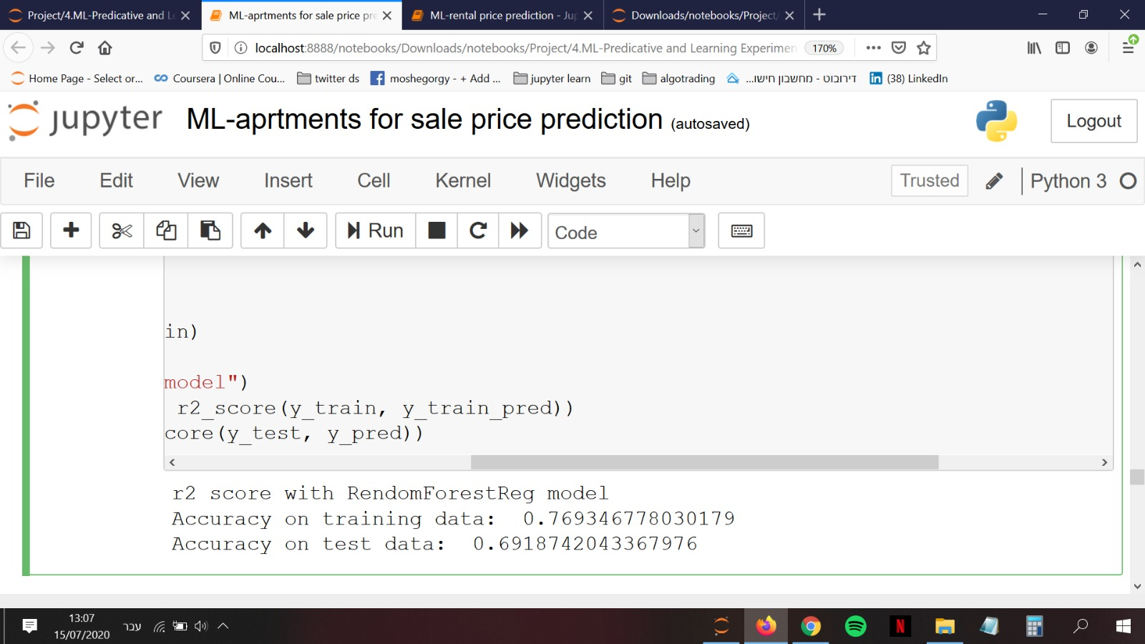
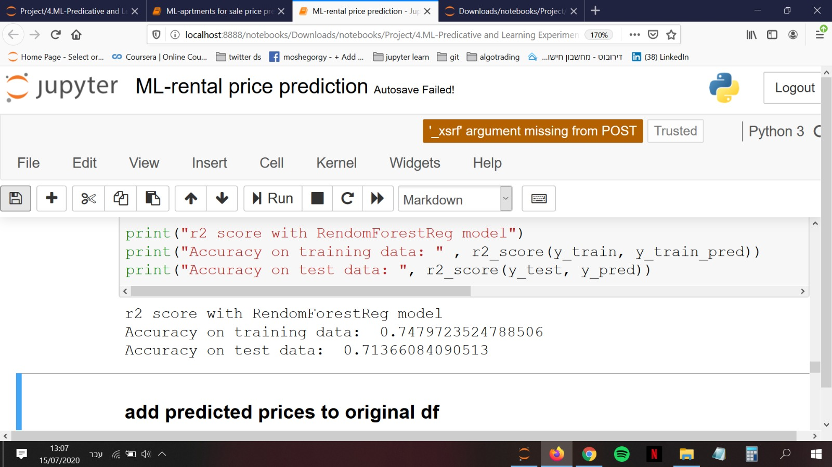
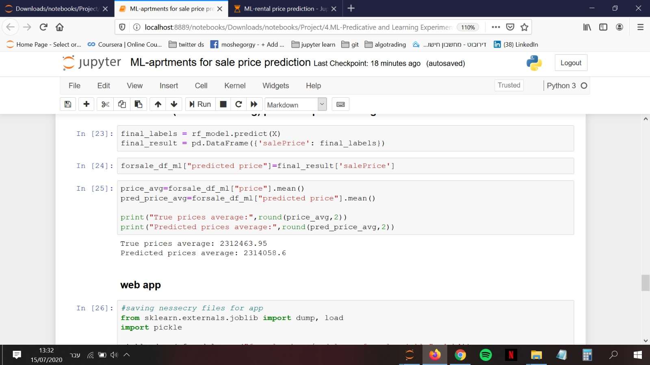
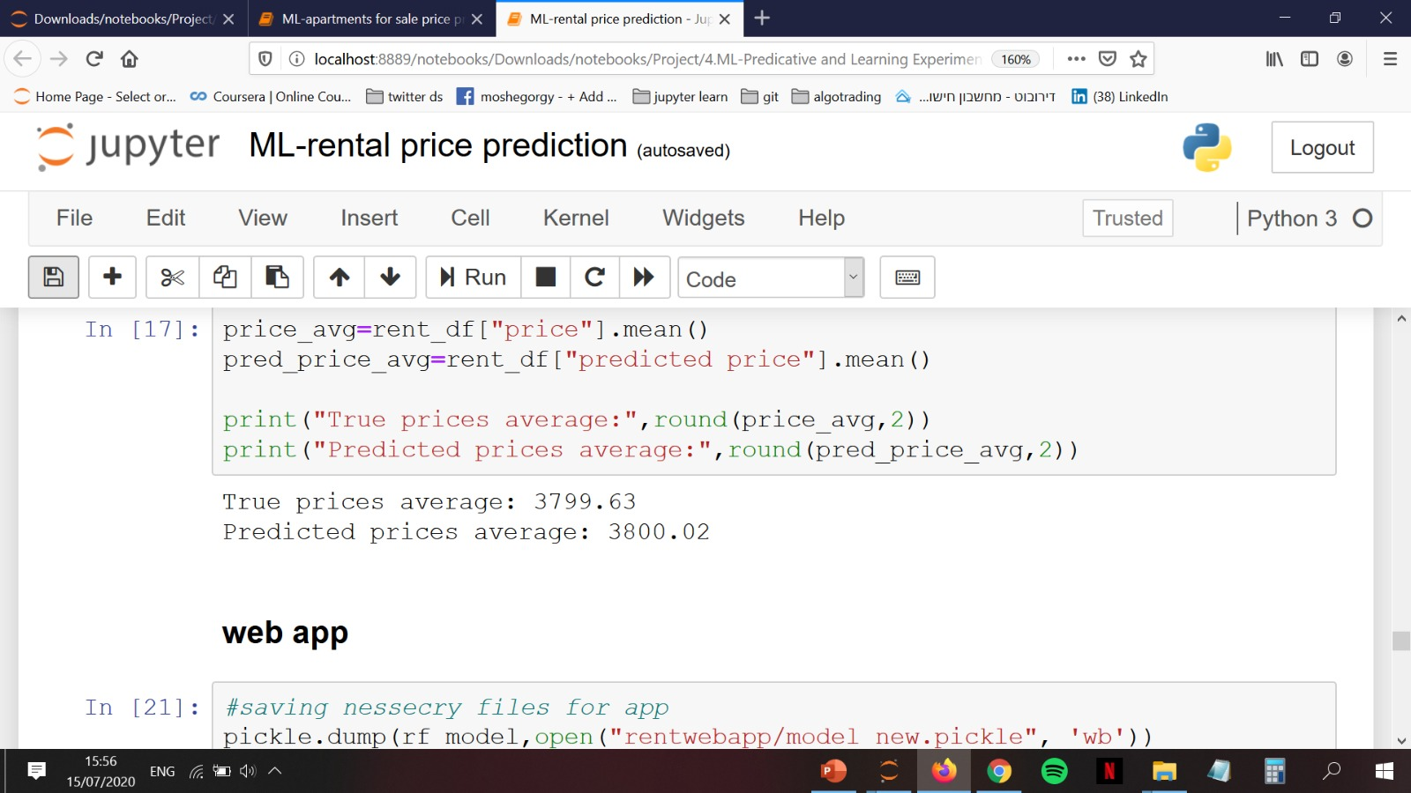
Random Forest Regressor
Like the previous models, we preprocessed the features that required for this model.
Because this model is very complicated we used GreedSearchCV for Hyper-parameter tuning
Although this model’s run-time is not very efficient its got the best results:
We tried to minimized overfitting by lowering the max depth and features of this tree model.
To be sure that model is working well with this minimal overfitting we ran the model for each apartment in our data and predict its price and add it to the dataframe.
After checking the averages of the true prices against the predicted prices we got these minimal gaps between the prices:
Apartment for Sale:
Apartment for rent:
Apartment for Sale:
Apartment for rent:

Slide 29

Deploying the models to an Web App

Slide 30

Price Prediction – Web App
After finding the model with the best accuracy we decided to implement this model by generating a web-app
we used Anvil services to connect the jupyter-notebook to an interface we created for the app
Try it on your own asset!!!
Asset value calculator
Rent value calculator

Slide 31


Slide 32
Conclusion and Interpretation
We found which parameters influent the most on the rent price and the asset price.
We found out what is the impact of COVID-19 epidemic on the real-estate market in Israel.
After deploying our predictive models we saw that the most complicated model has best accuracy and it becomes more accurate when the data set is bigger
To show the final results of the project we built a web-app for making it more accessible and realistic
According to our data the real-estate market in Israel is becoming more expensive even during the pandemic where the supply is low.

